Slide 1
PP3: Mitosis
Year 10 Science

Slide 2
Diploid cells
The cells that make up your muscles, nerves, skin, bone, fat, blood, all your organs and most of your other cells are called somatic (body) cells.
Somatic cells are referred to as being diploid
Chromosomes in diploid cells exist in pairs, the members of each pair being similar in size and shape. One of the pair was inherited from your father, the other from your mother, making what is called a homologous pair of chromosomes.
Diploid cells contain a complete set of chromosomes and therefore a complete set of coded instructions about how your body is put together.

Slide 3
Haploid Cells
Gametes are the reproductive cells, ova (eggs) in females and sperm in males (and pollen in male plants)
Gametes are different to all other cells. They contain only one copy of each chromosome (not two of each as in somatic cells)
They are known as haploid cells. Gametes combine to form the first cell of a new organism during fertilisation – called a zygote.
The zygote has a full quota of chromosomes (diploid) and grows into an embryo
An embryo is an unborn or unhatched offspring
This is how a child gets half of its genetic info from each parent

Slide 4
Cell reproduction
The chromosomes in every one of your somatic cells are an exact copy of those in the zygote
A zygote, grows into an embryo and a baby and onto an adult with millions of cells with identical chromosomes
Your body is continually replacing old cells, or may need to repair damaged cells from disease or injury
How does this information get passed onto new cells?

Slide 5

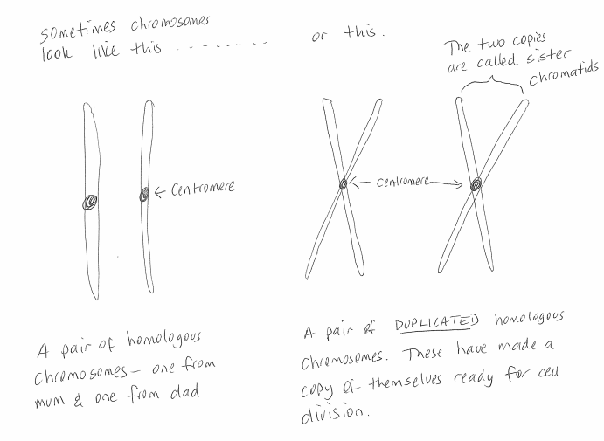
Duplicated chromosomes

Slide 6
Mitosis
Steps of Mitosis
Diploid cells are reproduced by first duplicating their chromosomes
When each cell divides, two diploid daughter cells, each receive an exact copy of the chromosomes from the parent cell
This type of cell division is called mitosis
Mitosis occurs in a series of steps
Remember IPMATCI
Interphase
Prophase
Metaphase
Anaphase
Telophase
Cytokinesis
Interphase

Slide 7
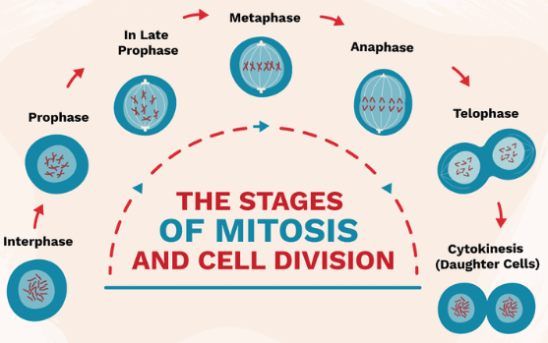

Slide 8
Interphase occurs before mitosis begins
Chromosomes are copied (Number doubles)
(in humans goes to 92)
Chromosomes appear as threadlike coils called chromatin at the start of interphase
By the end of interphase, the chromosomes appear as two identical chromatids joined at the centromere
Nucleus
Cytoplasm

Slide 9
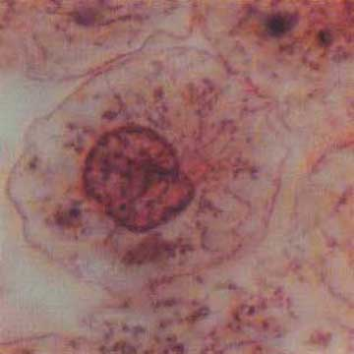
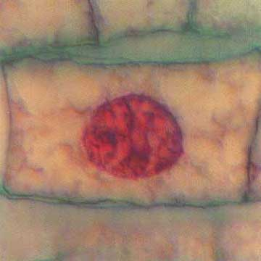
Interphase
Animal Cell
Plant Cell
Photographs from: http://www.bioweb.uncc.edu/biol1110/Stages.htm

Slide 10
Prophase 1st step in Mitosis
Mitosis begins (cell begins to divide)
Centrioles (or poles) appear and begin to move to opposite end of the cell.
Spindle fibers form between the poles.
Duplicated chromatids
Centrioles
Spindle fibers

Slide 11
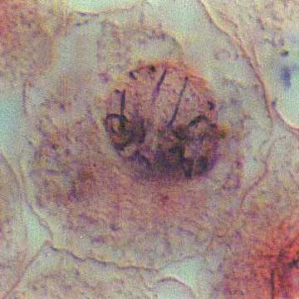
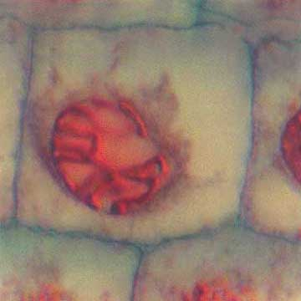
Prophase
Animal Cell
Plant Cell
Spindle fibers
Centrioles
Photographs from: http://www.bioweb.uncc.edu/biol1110/Stages.htm

Slide 12
Metaphase 2nd step in Mitosis
Chromatids (or duplicated halves of chromosomes) attach to the spindle fibers at the centromere
Centrioles
Spindle fibers

Slide 13
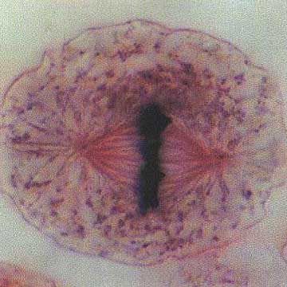
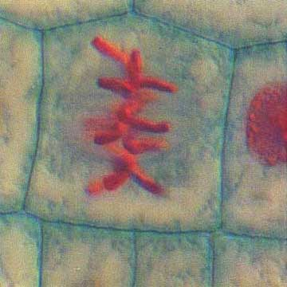
Metaphase
Animal Cell
Plant Cell
Photographs from: http://www.bioweb.uncc.edu/biol1110/Stages.htm

Slide 14
Anaphase 3rd step in Mitosis
Chromatids separate and begin to move to opposite ends of the cell.
The spindle fibers pull the chromatids apart, so one copy of each is moving to opposing ends of the cell
Centrioles
Spindle fibers

Slide 15
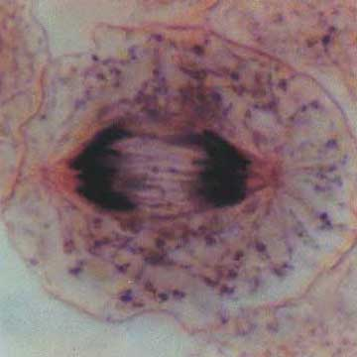
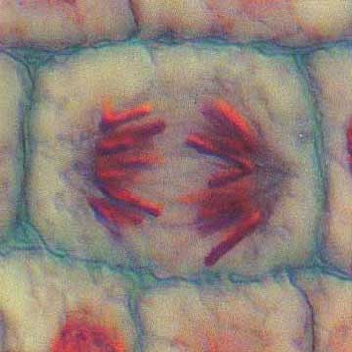
Anaphase
Animal Cell
Plant Cell
Photographs from: http://www.bioweb.uncc.edu/biol1110/Stages.htm

Slide 16
Telophase 4th step in Mitosis
Two new nuclei form.
Chromosomes appear as chromatin (threads rather than rods).
Mitosis ends.
Nuclei
Nuclei
Chromatin

Slide 17
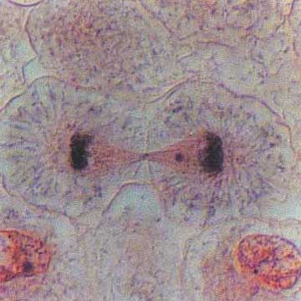
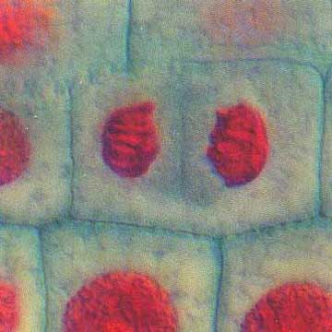
Telophase
Animal Cell
Plant Cell
Photographs from: http://www.bioweb.uncc.edu/biol1110/Stages.htm

Slide 18
Cytokinesis occurs after mitosis
Cell membrane moves inward to create two daughter cells – each with its own nucleus with identical chromosomes.
Two Daughter cells, enter Interphase again

Slide 19
Asexual Reproduction
Some organisms have to ability to reproduce without the fertilisation of gametes
The offspring are genetically identical as the parents and mitosis is used
Examples, many plants can grow from cuttings, strawberry runners, potato tubers, starfish growing a new body from a leg broken off, bacteria, stick insects lay eggs identical to female with no mating.

Slide 20
Animation
http://www.sumanasinc.com/webcontent/animations/content/mitosis.html
Activity
Working in pairs, your task is to create a model of mitosis.
Use class notes and internet animations to make a model of a cell undergoing mitosis.

Slide 21
Model Instructions
Every model must show each phase of mitosis;
Interphase (parent cell),
Prophase,
Metaphase,
Anaphase,
Telophase,
Cytokinesis and
Interphase (2 new daughter cells)
The parent cell should start with 4 chromosomes.
Each phase should include the following labels where appropriate;
Cell Membrane
Nucleus (where present)
Chromatin/Chromosomes/chromatids/centromeres
Centrioles
Spindle Fibres
A small written explanation should be provided for each phase
The format of the model is up to you.

Slide 22
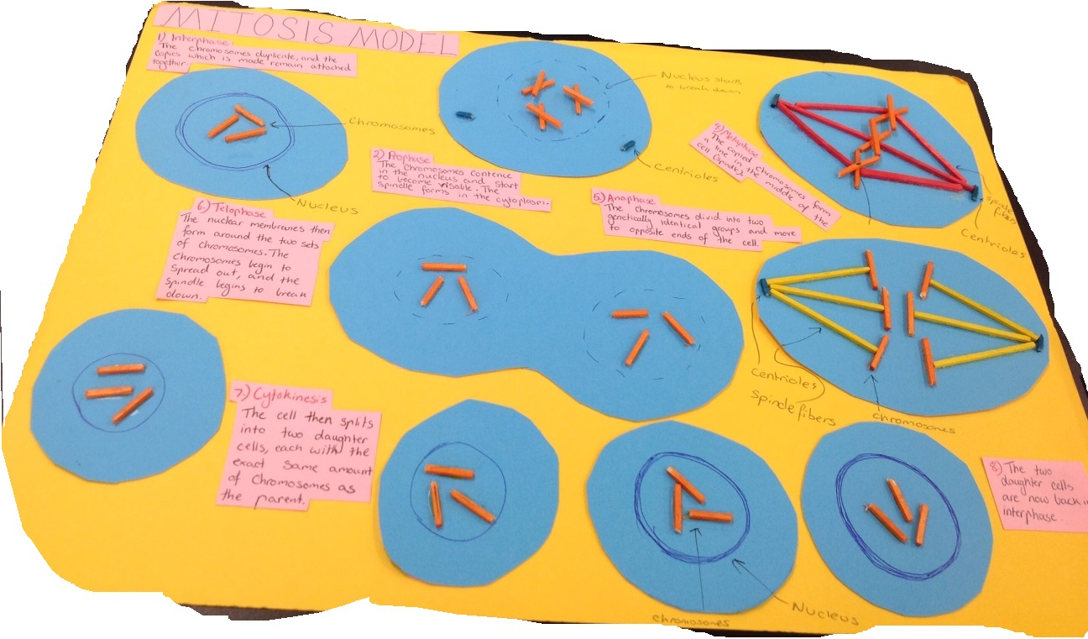
Poster models

Slide 23
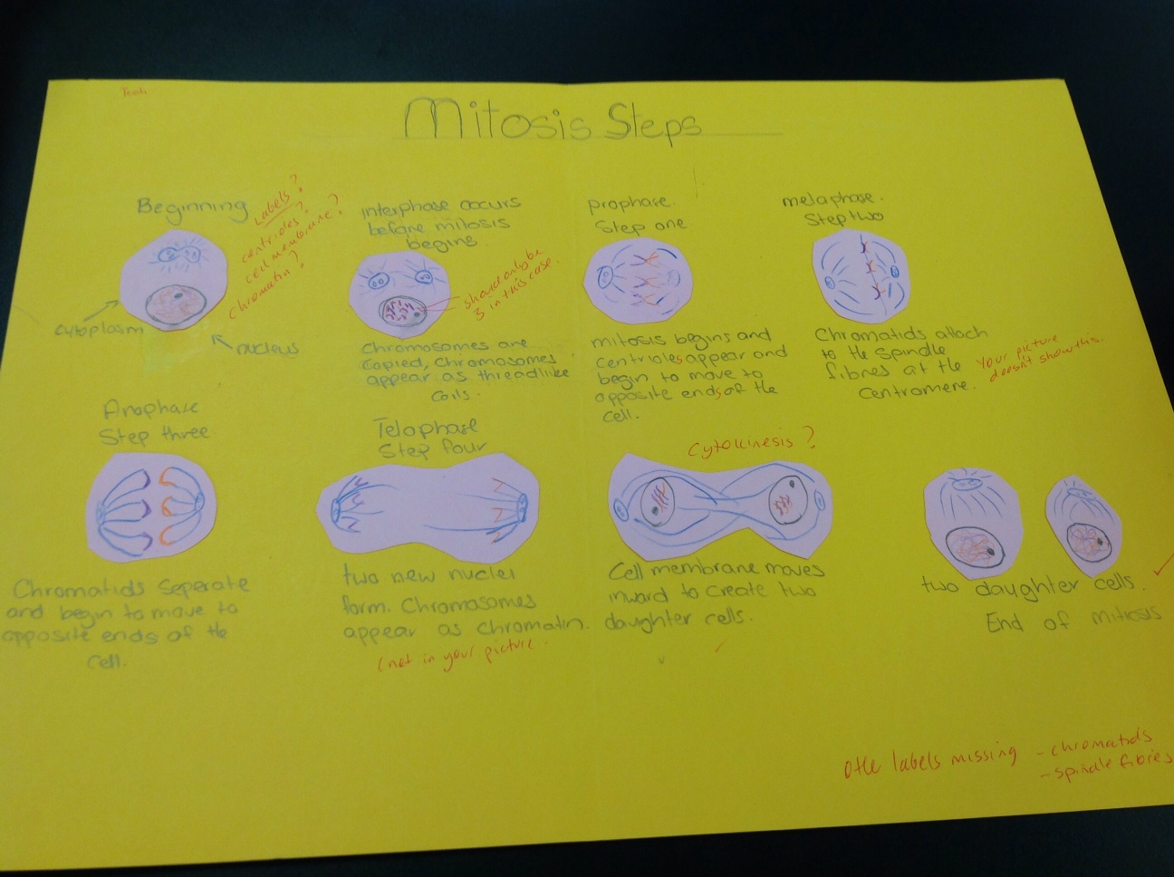

Slide 24
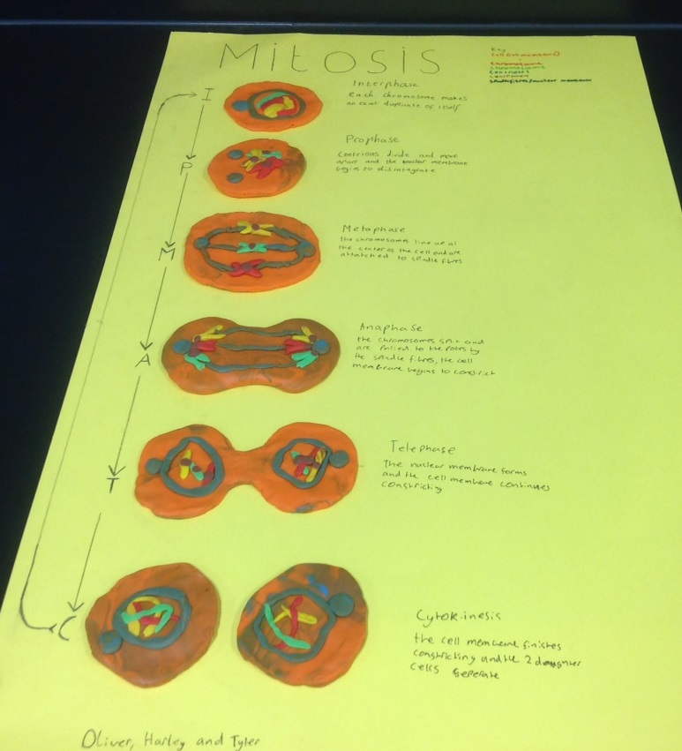
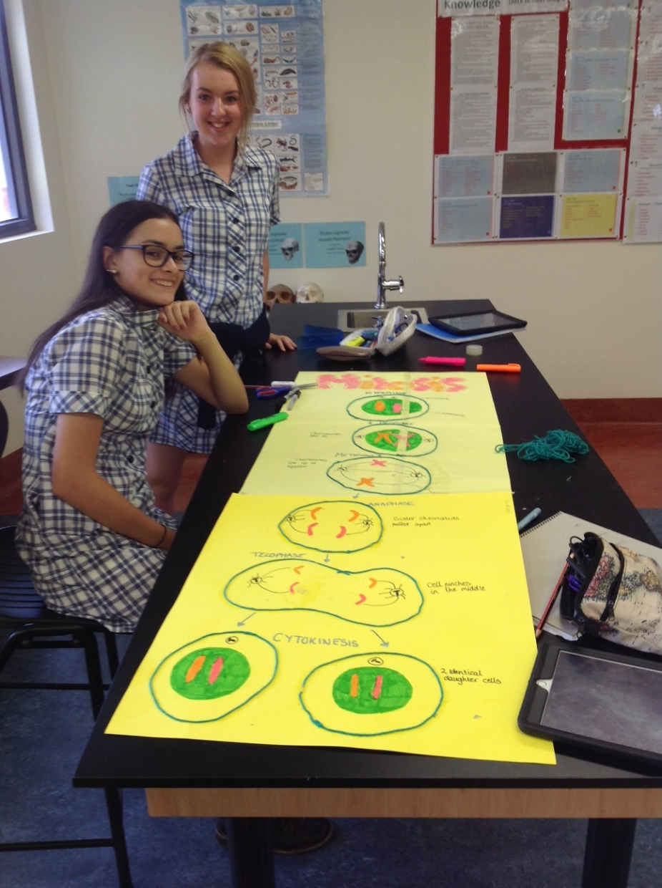

Slide 25
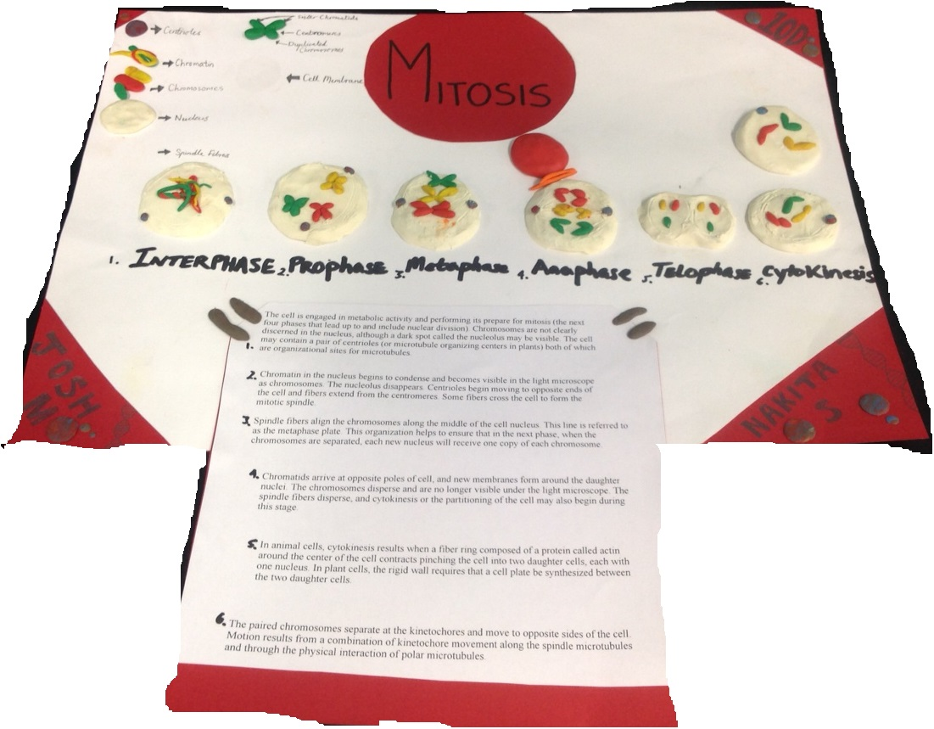

Slide 26
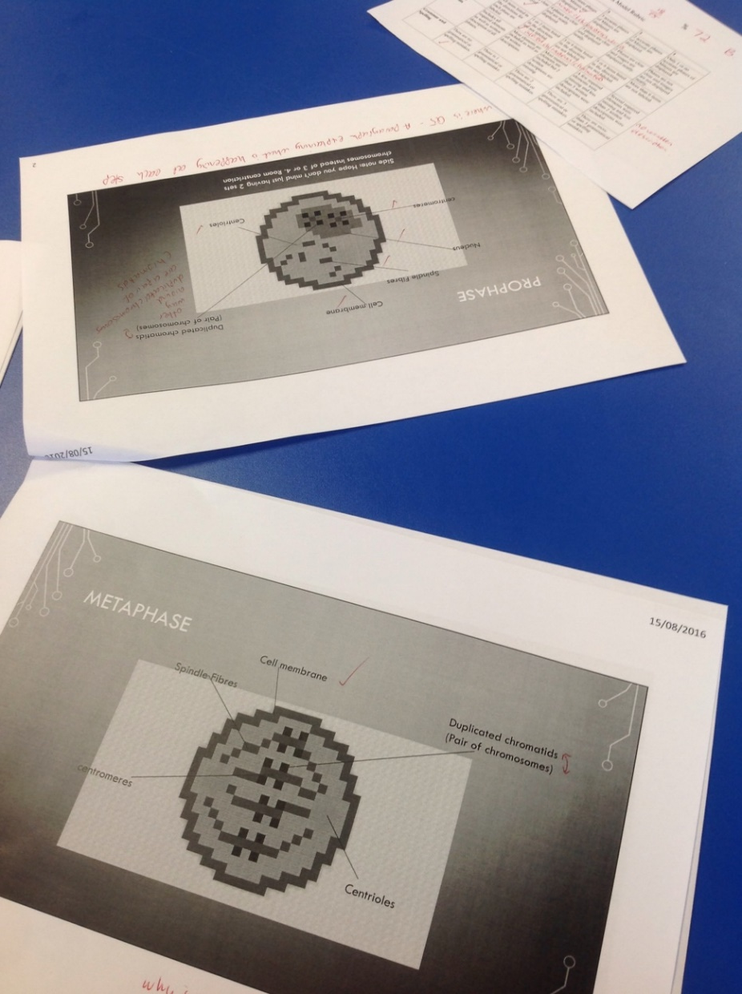
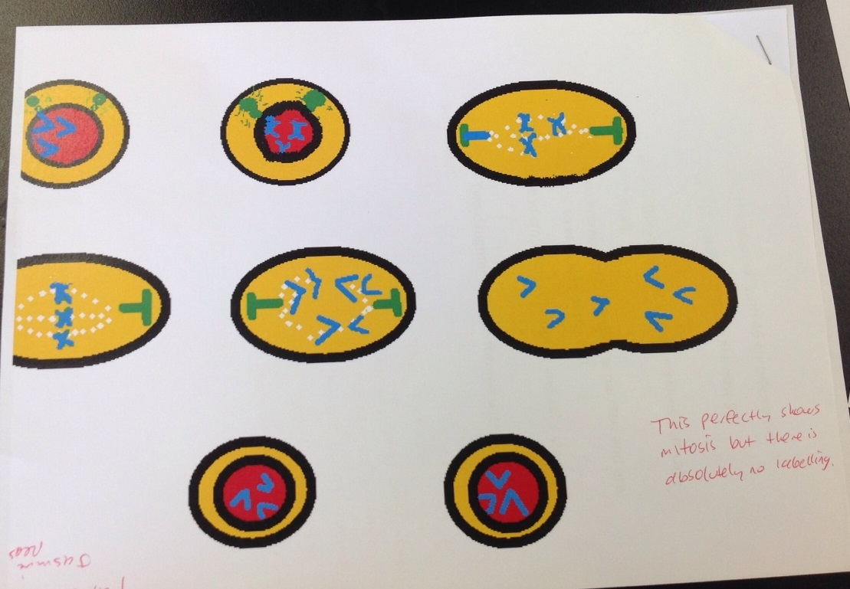
Digital Models

Slide 27
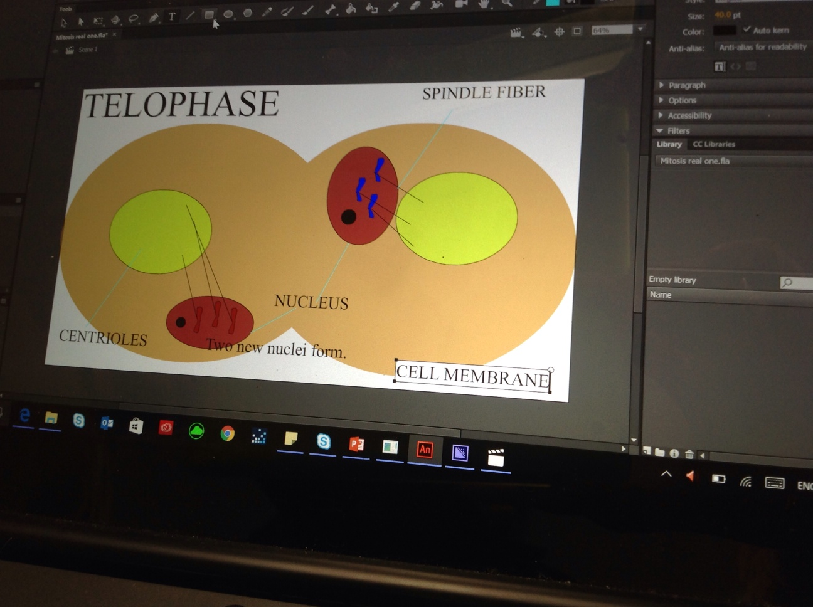

Slide 28
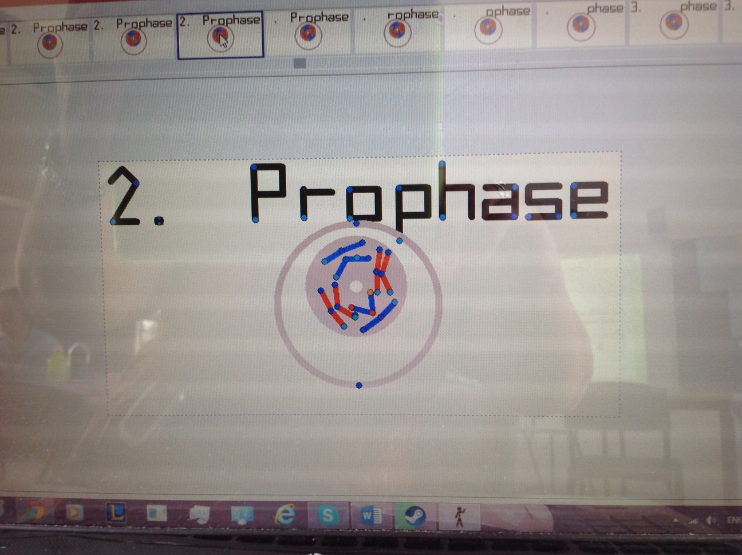

Slide 29
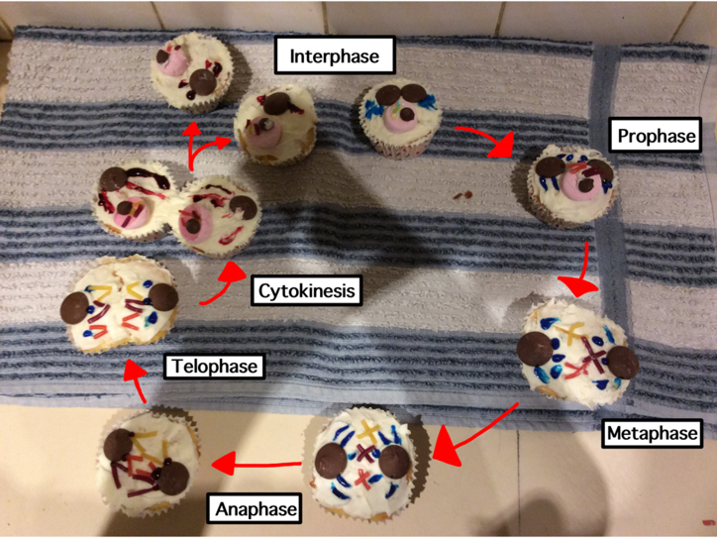
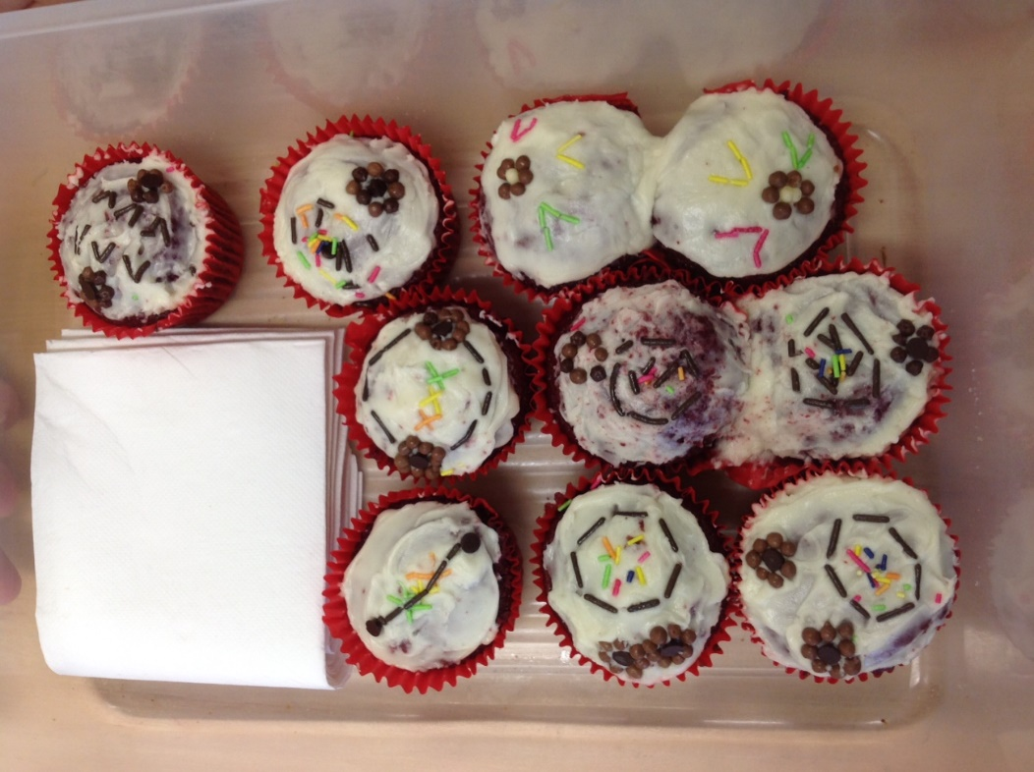
Food Models

Slide 30
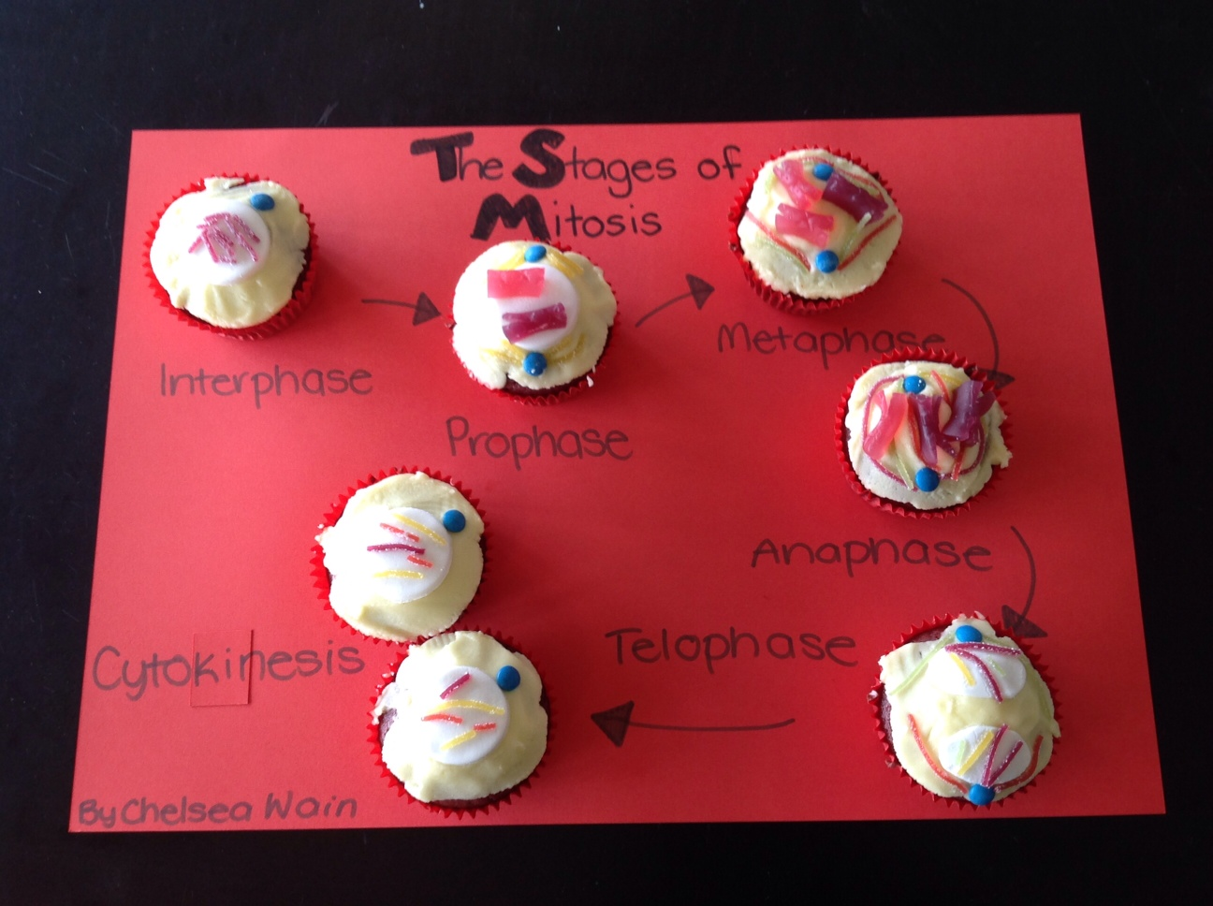

Slide 31
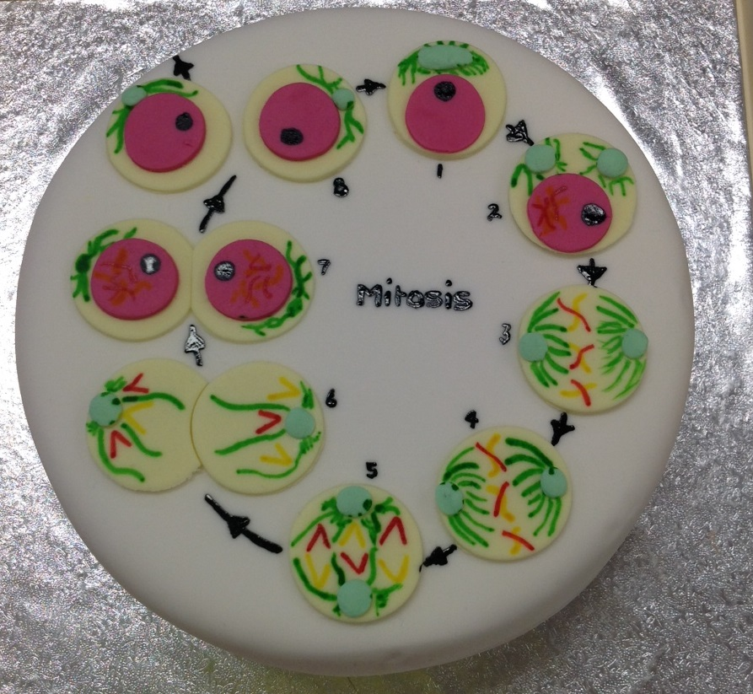
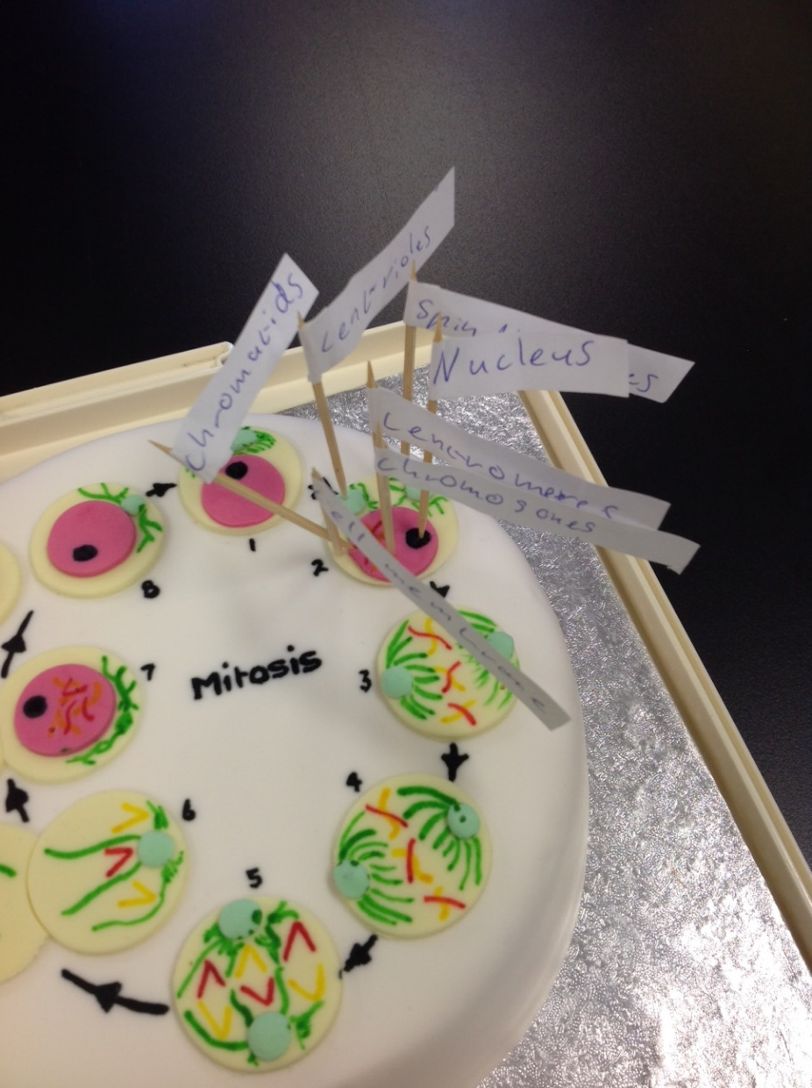

Slide 32
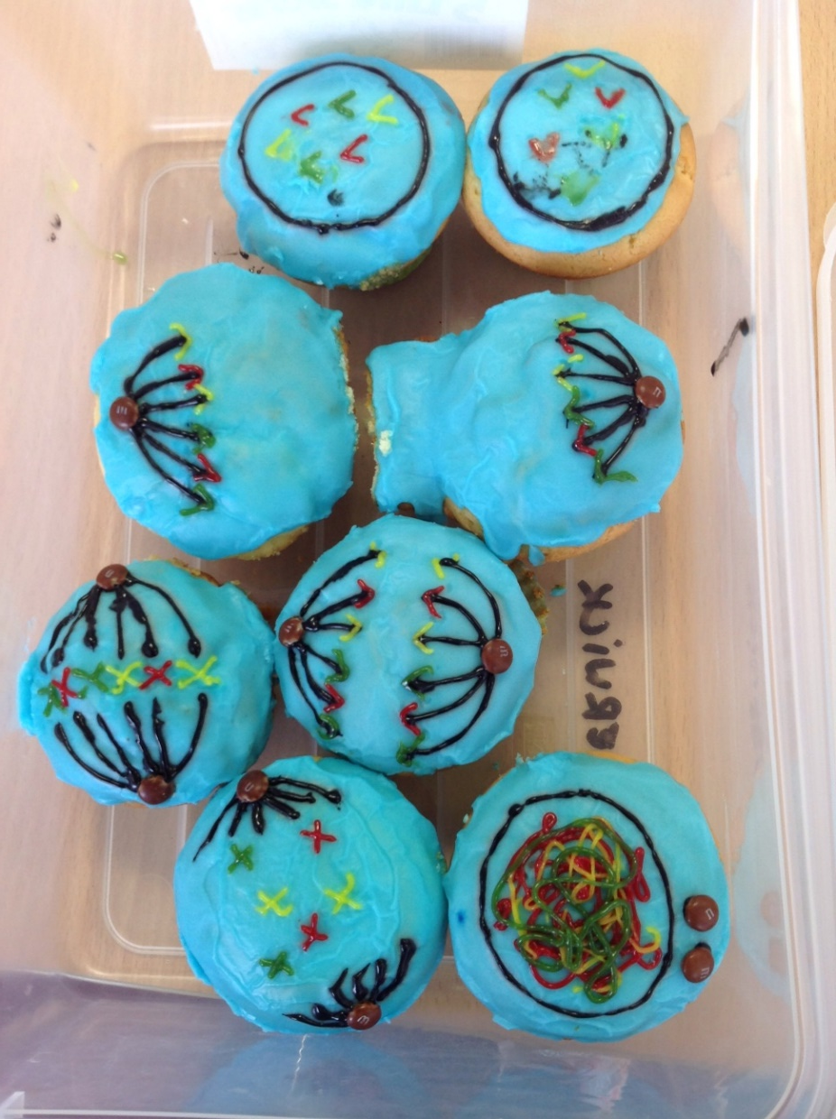
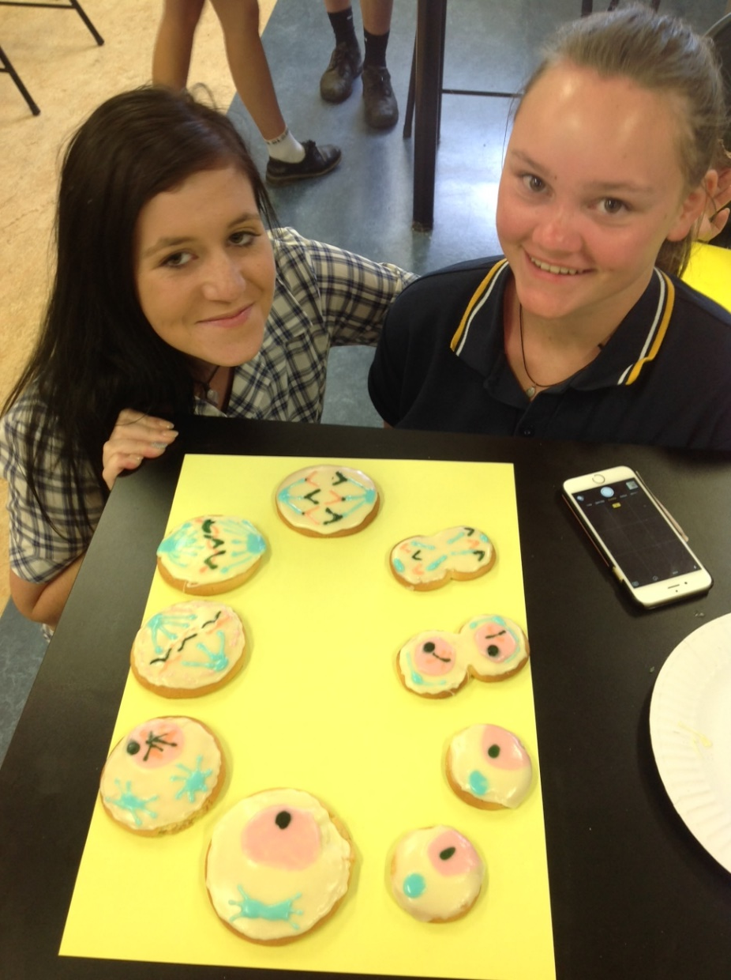

Slide 33
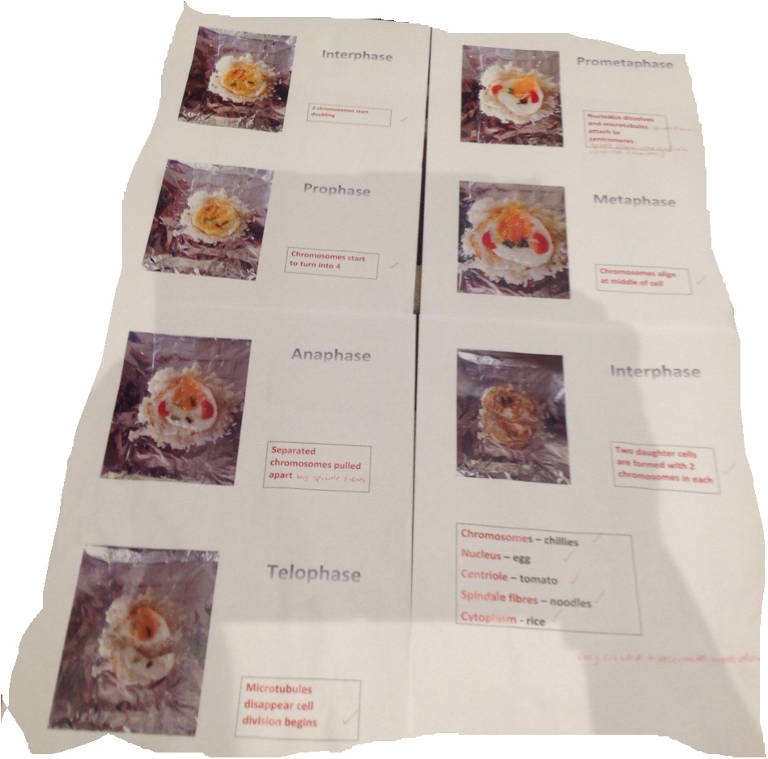
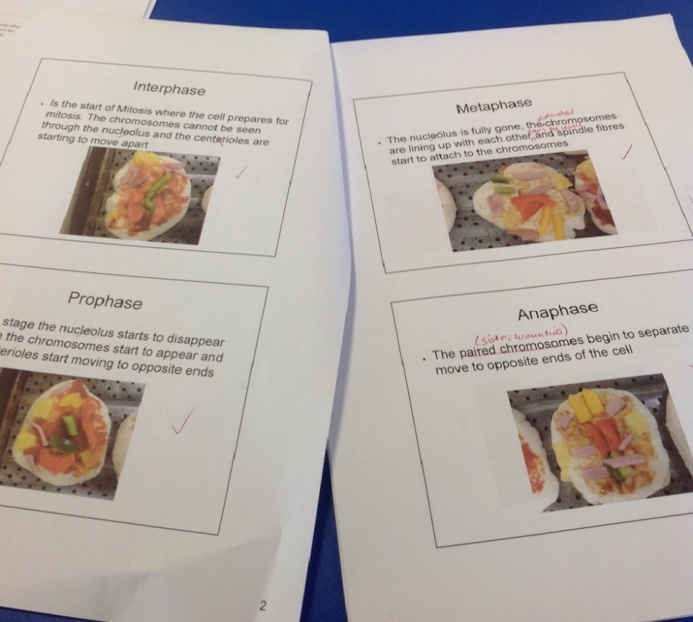
Pizza (above) 2 minute noodles (Right)

Slide 34
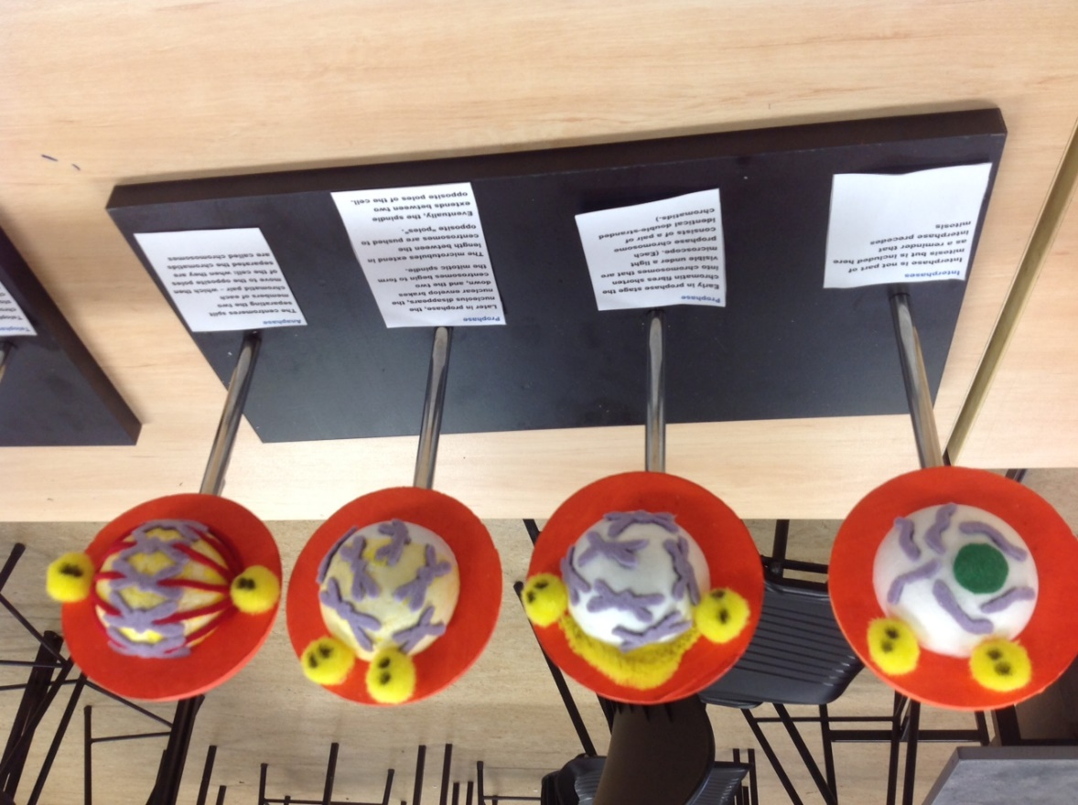
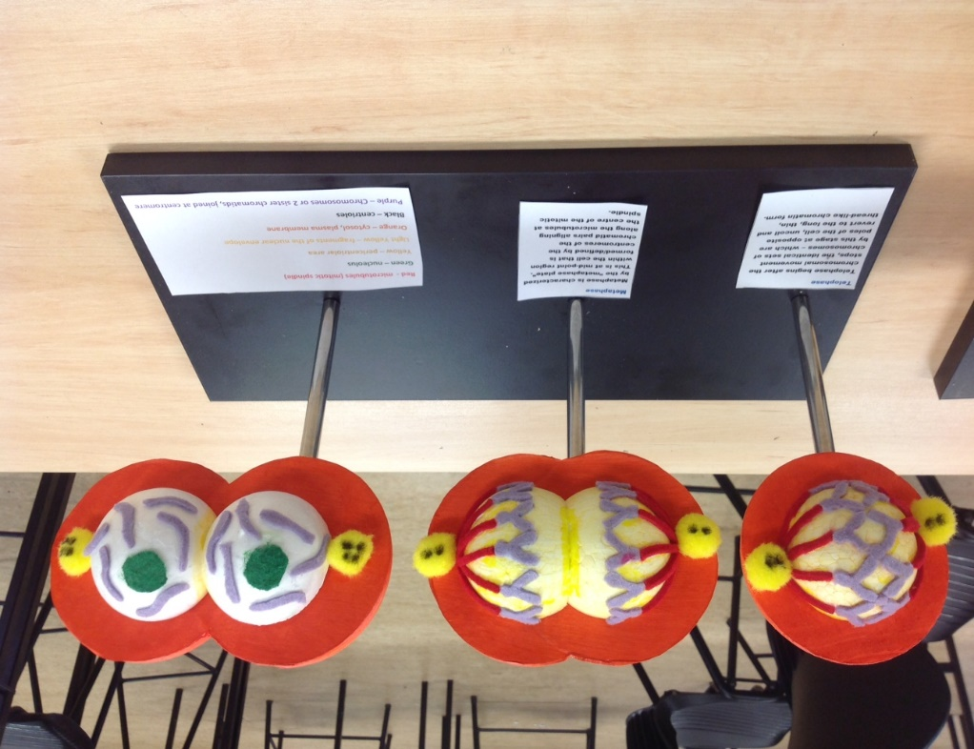
3D models

Slide 35
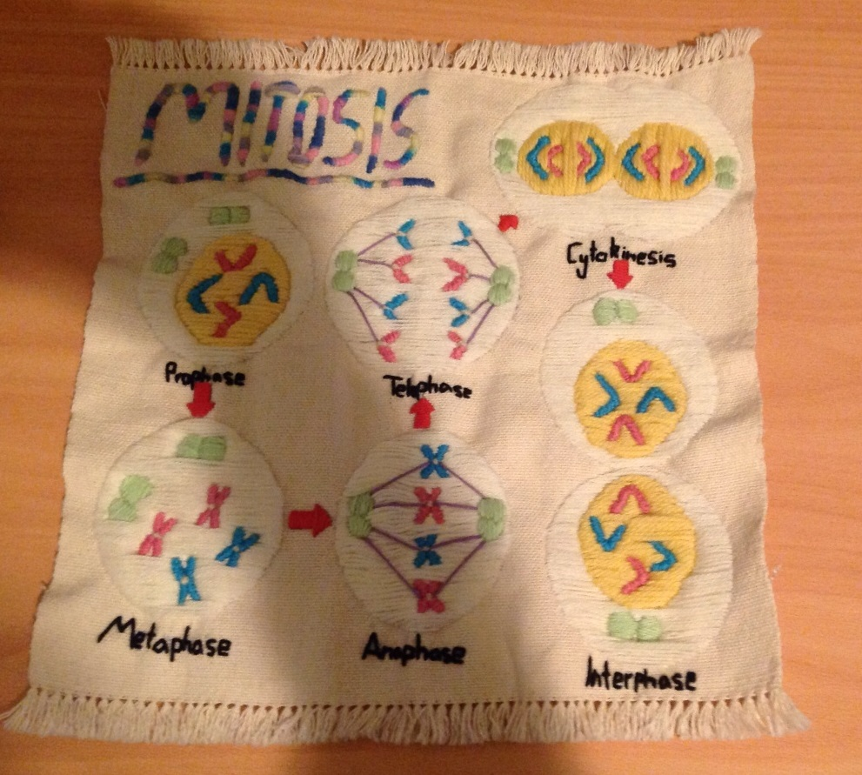

Slide 36
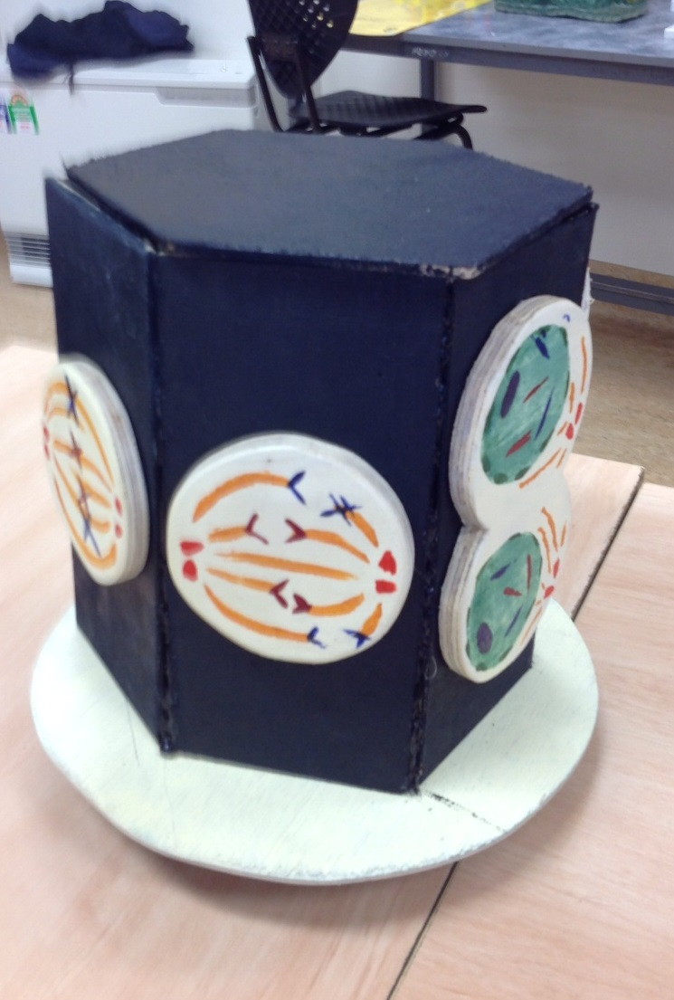
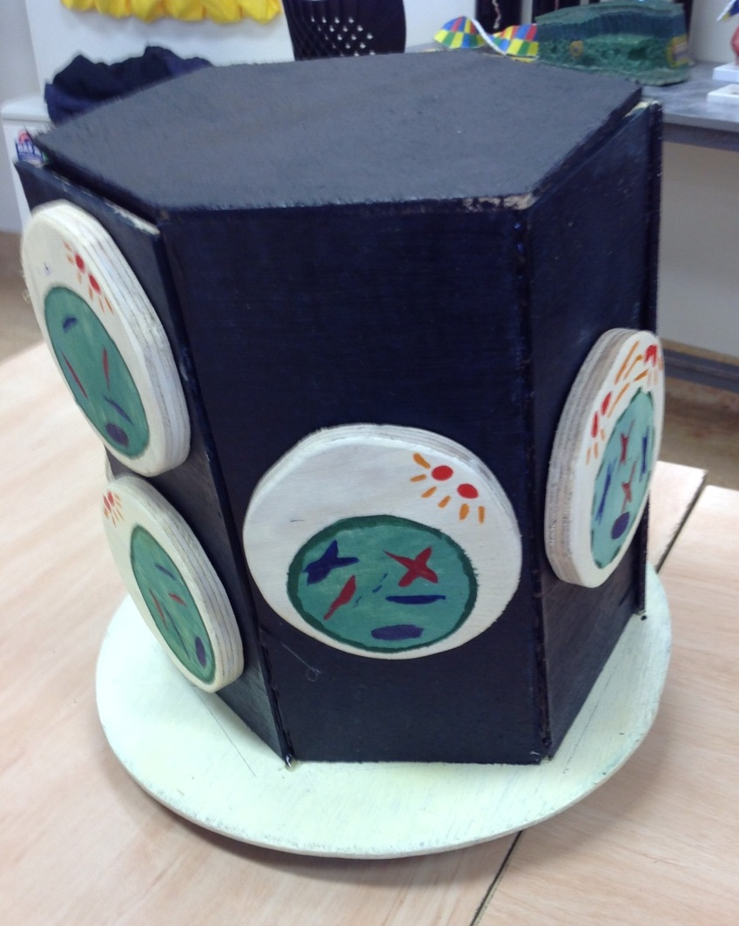

Slide 37
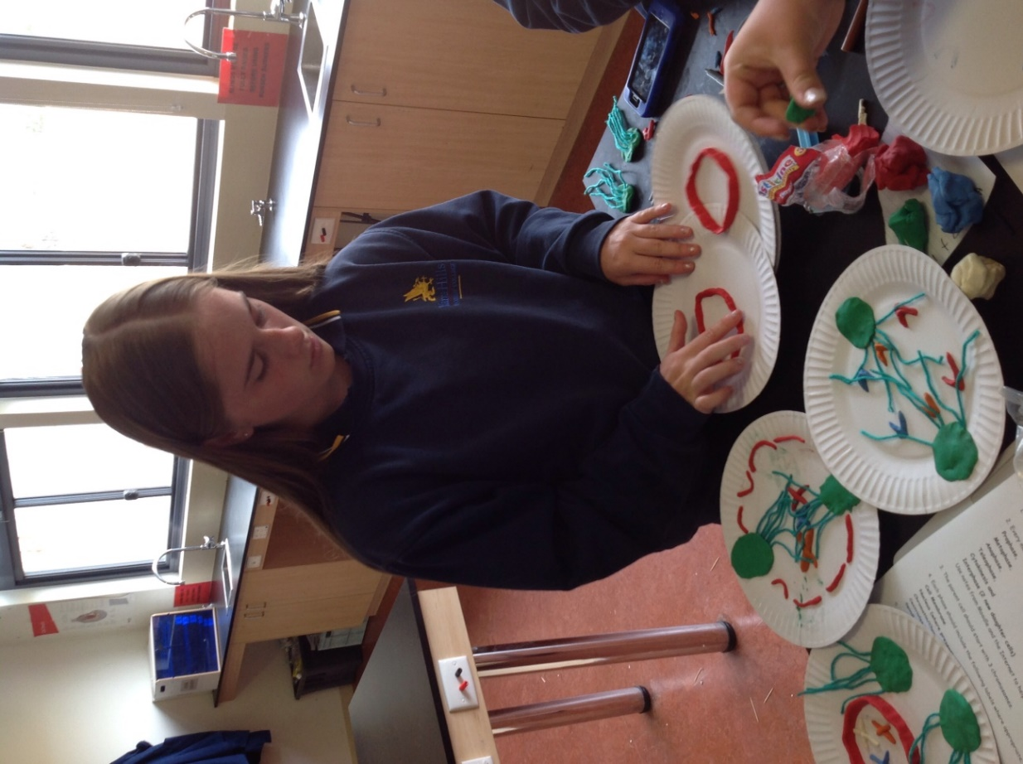
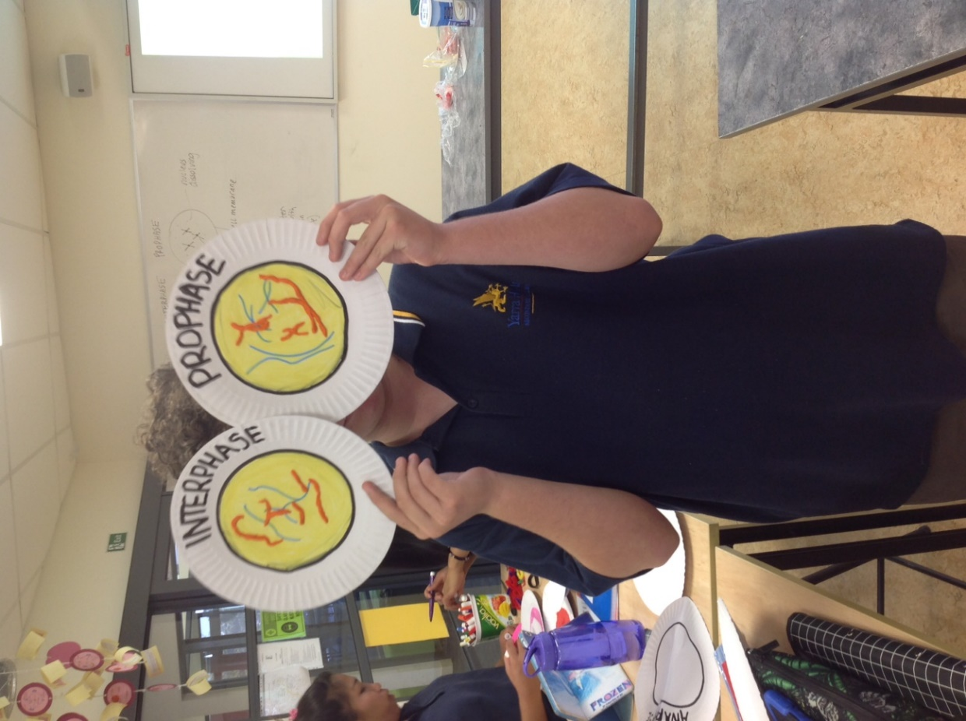

Slide 38
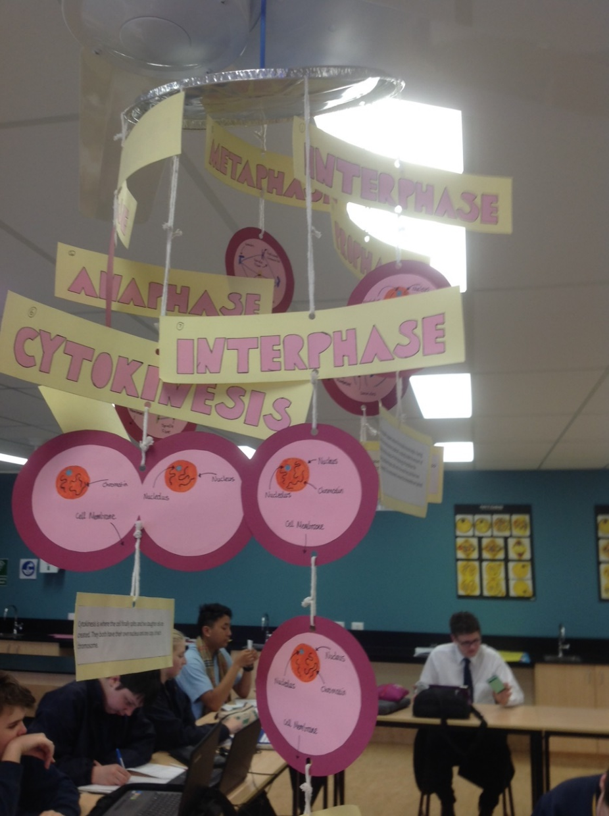
Have you got any other ideas?

